Slide 1
Ideas For The Website

Slide 2
How to create a website
Finding a website hosting(standart web hosting)
Domain name
www.natro.com
digi-class.com
digi-class.net
digi-class.org

Slide 3
Which form do we use in our site?
a)Classical form(for official websites)
It serves information only.
b)Dynamic web page(interactive)
It allows interaction between site owner and visitor.

Slide 4
Content of the website
Notice board
Introductory video
About the project(summary of it and details)
Digital tools

Slide 5
Partner details
Mobilities
Photo gallery
Links(e-twinning)
Contact us

Slide 6
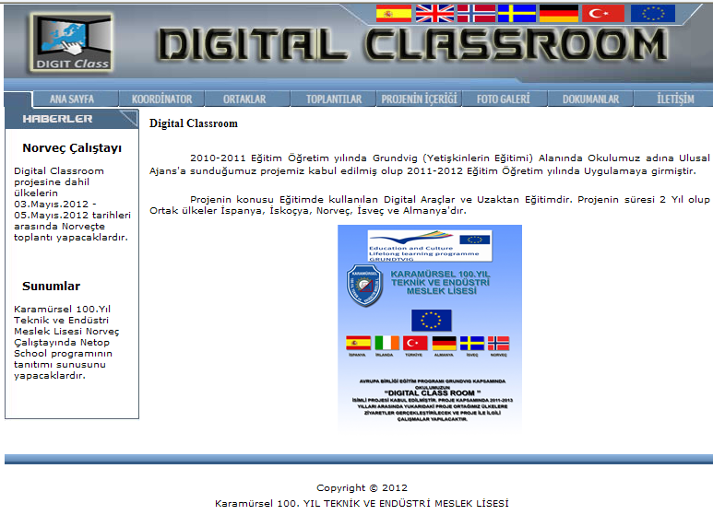

Slide 7
How to design it?

Slide 8
Who is going to be responsible to update the website?

Slide 9
The further use of website

